Slide 1
Healthy Treats Case Study
Prepared by: Lianxin Yu

Slide 2
Agenda
Background
Business Objectives
Analytical Approach and Assumption
Data Overview/Understanding/Preprocessing
Part I Analysis Overview
Key Findings I/II/III
Part II Analysis Overview
Key Findings I /II
Recommendations

Slide 3
Background
“Healthy Treats” is a small sized grocer
Goal is to stretch its market share to 4.5% by the end of the year; current is around 3%
“Healthy Treats” believes the best marketing strategy involves identification of customers and categories which should be prioritized for marketing
Customer spending and opportunity is believed to be affected by customer life stage, life cycle, age, income and neighborhoods

Slide 4
Business Objectives
Target high spending customers with high opportunity
PART I
Identify high-spend vs low-spend customers and categories
PART II
Identify high-opportunity vs low-opportunity customers and categories

Slide 5
Analytical Approach and Assumption
PART I
Segment customers based on total annual spend on healthy food
Understand the differences between high spenders and low spenders
Part II
Segment customers based on customers attributes
Identify clusters with high-opportunity and low-opportunity customers
Understand the differences between high-opportunity and low-opportunity customers
Assumption
Annual spend is unknown before clustering

Slide 6
Data Overview
Sample of 5000 Potential Customers
Customer life stage and life cycle – Internal
Other categories – Third Party Providers
Information at Customer Level
Categorical Variables (customer attributes): life stage, life style, age group, income group, neighborhood
Numerical Variables (customer spend in each category): grain, vegan bakery, exotic fruits and vegetables, organic drinks, pre-made salad, no-meat burger , gluten-free bakery , no-dairy

Slide 7
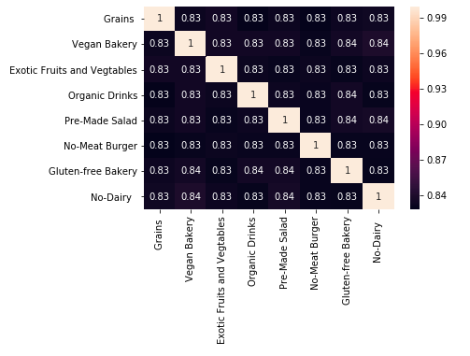
Data Understanding
Missing Values
Life Stage 13%, Age Group 10%, Income Group 10%, Life Style 25%, Neighborhood 10%
53% rows of customer records have at least one missing value
Numerical Variables
All categories are highly correlated

Slide 8
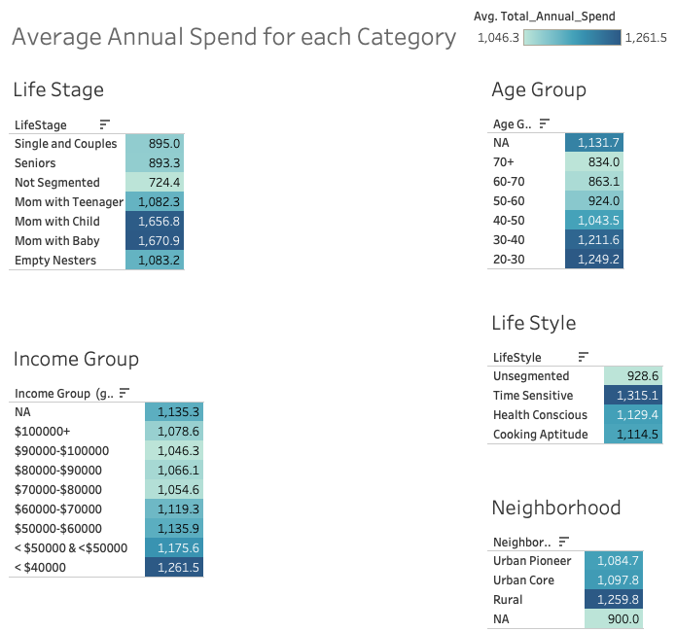
Data Understanding
On average, moms with at least a child or a baby spend the most, seniors spend the least
Income is inversely related with average spend
The youngest group spends 1.5 times as much as the oldest group
Customers in rural areas spend more than customers in urban areas
Time sensitive customers tend to spend more than health conscious customers

Slide 9
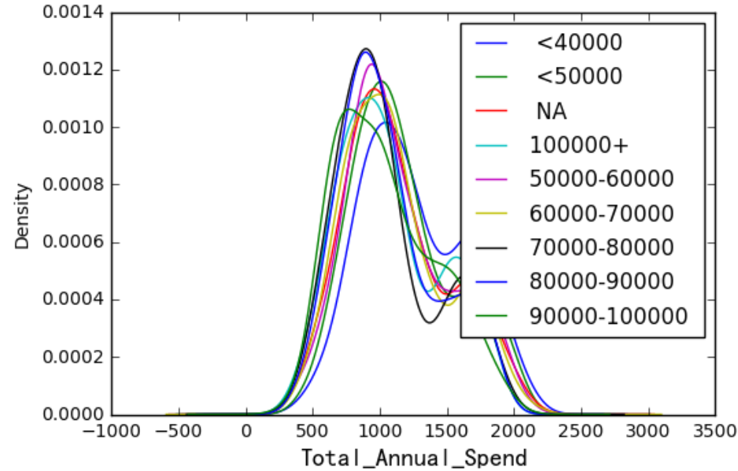
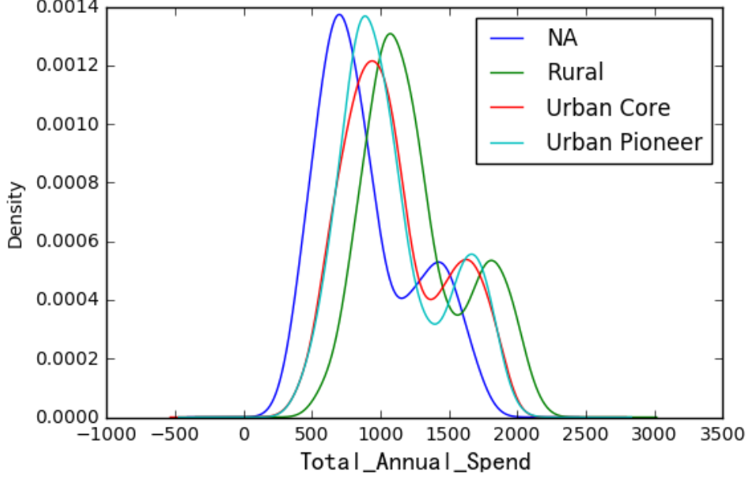
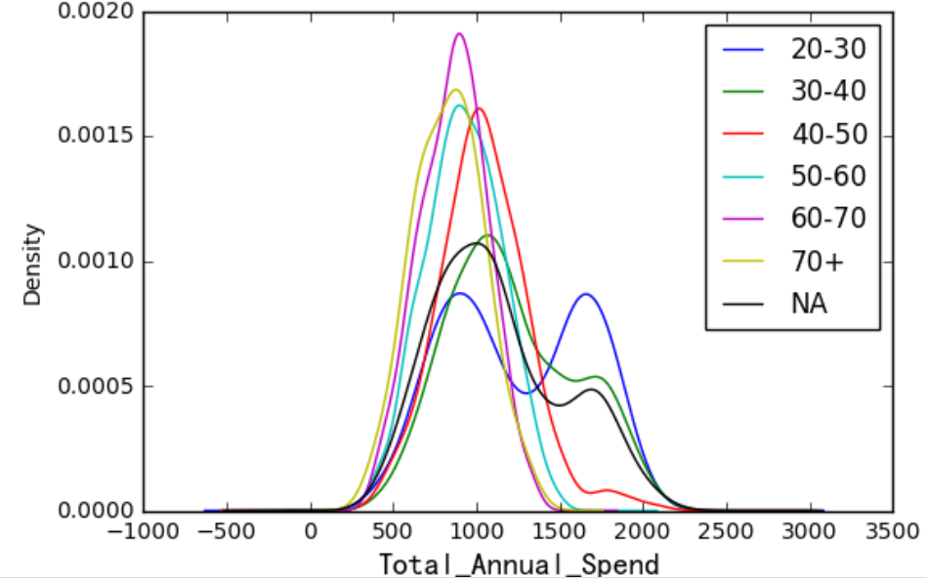
Data Preprocessing
Income
Missing value imputation
Within each variable, the missing category has a similar distribution as other categories except for neighborhood
Missing value groups stand in different positions in each category in terms of average annual spend
Neighborhood
Total Annual Spend Distribution Graphs
Age
Impute the missing values by padding except for neighborhood because its ‘NA’ category is far from others
Notes:
”NA” category in neighbor is farther from other categories compared to income and age group
“pad’ fill in NaNs using existing values
leave the missing categories as separate categories
Missing Percentage: Life Stage(13%), Age Group(10.26%), Income Group(9.96%), Life Style(24.98%), Neighborhood(10.42%)
No overlap between the group <$50000 and <$40000, therefore, substitute <$50000 with $40000 - $50000

Slide 10
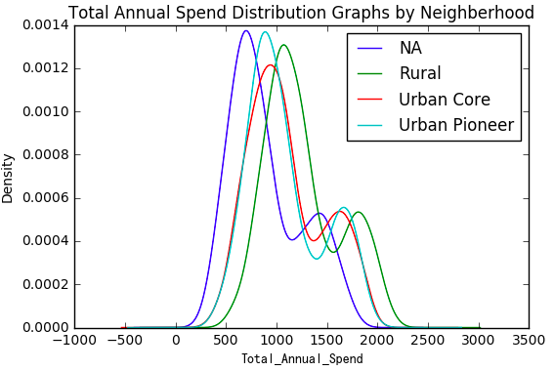
Data Preprocessing
Create Dummy Variables & Bin Categorical Variables
Bin categories with similar distributions for better clustering and targeting
Neighborhood: NA, Rural, Urban Core &Urban Pioneer

Slide 11
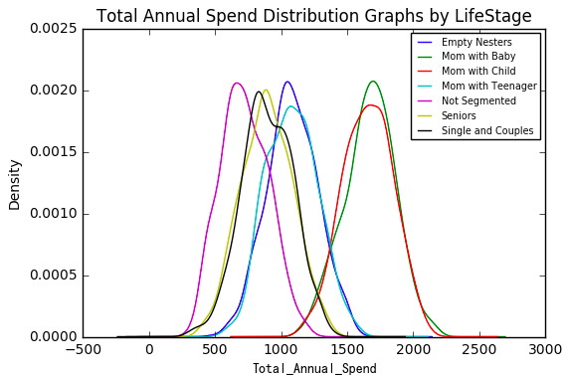
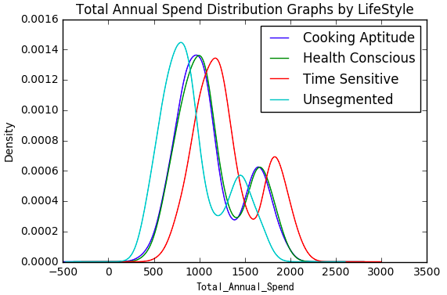
Data Preprocessing
Bin Categorical Variables & Create Dummy Variables
Life Stage: Mom with Baby & Mom with child, Mom with Teenager& Empty Nesters, Seniors& Single and Couples, Not Segmented
Lifestyle: Time Sensitive, Cooking Aptitude& Health Conscious, Unsegmented

Slide 12
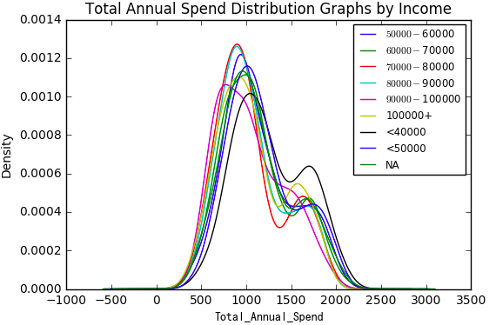
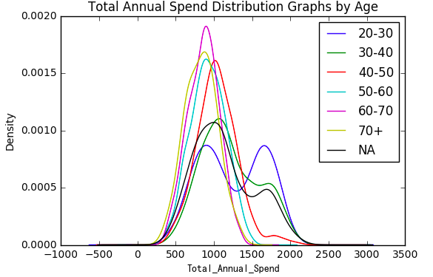
Data Preprocessing
Bin Categorical Variables & Create Dummy Variables
Income Group: <$50000, >$50000
Age Group: 20-30&30-40,40-50, 50-60,60+

Slide 13
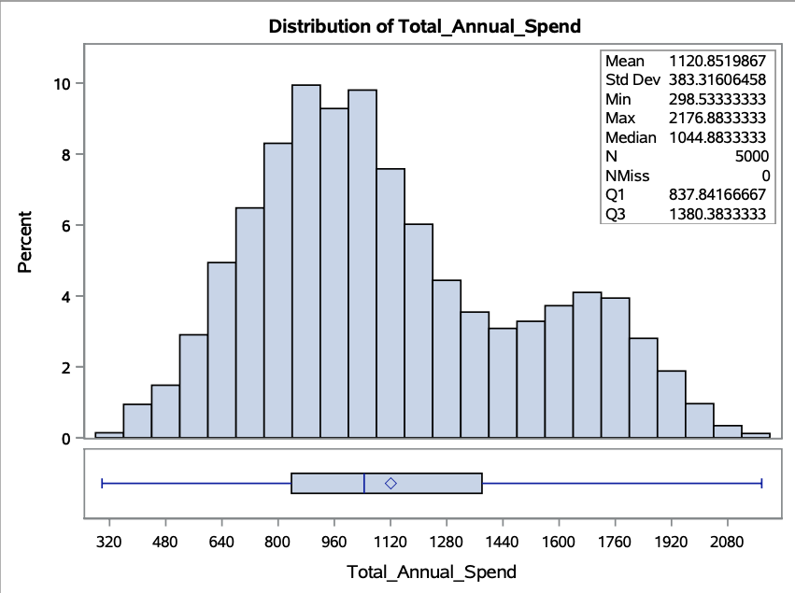
Part I Analysis Overview
Why classify customers based on Total Annual Spend?
Total annual spend is highly correlated with annual spend on each category
Identify high-spend vs low-spend customers
Use K-means clustering to segment the customers into high-spend and low-spend customers only based on total annual spend
Two clusters follow normal distributions

Slide 14
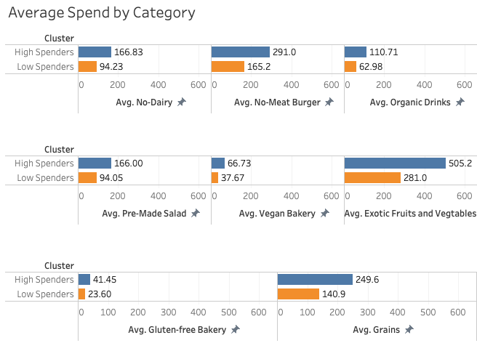
Key Findings I
High-spenders spend more on all categories than low-spenders
High-spenders and low-spenders have similar product preferences because their spending on each category is highly correlated
Notes:
The ratio is the highest in exotic fruits and vegetables(2.54) and lowest in organic drinks(2.35)

Slide 15
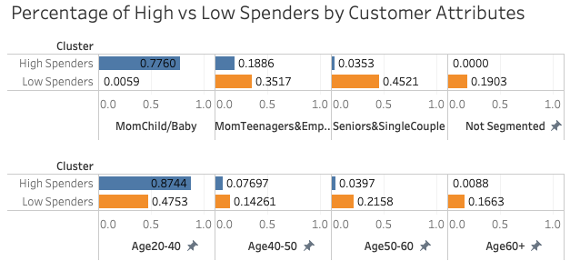
Key Findings II
Moms with at least one child or baby represents 77.6% high spenders , 0.6% low spenders
87.4% high-spenders and 47.5% low-spenders are between age 20-40
More seniors (age over 60) are low-spenders

Slide 16
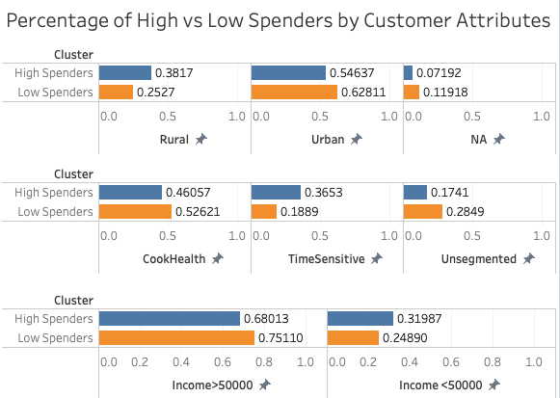
Key Findings III
The percentage of high-spenders in rural areas(38.2%) is higher than that of low-spenders in rural areas(25.2%)
More high-spenders are time sensitive and more low-spenders have unsegmented life style
The percentage of low-spenders with above average income is higher than that of high-spenders
Notes:
3011 customers are in urban，1468 are in rural areas

Slide 17
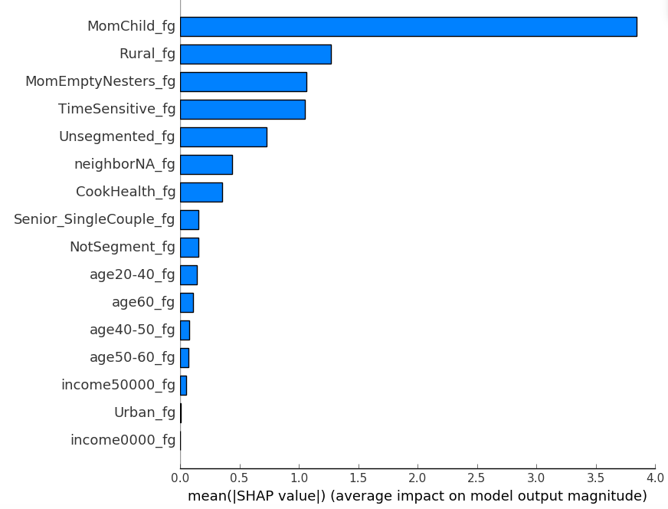
What’s next ?
Feature Importance - XGBoost Classification (Target: cluster)
What are the features that impact the classification of high-spenders and low-spenders?
XGBoost model used high-spend customers as target and all the customer attributes as predictors
The importance of customer attributes were ranked from high to low
Moms with at least one child or baby has the highest impact, living in rural areas and being time sensitive rank the second and third

Slide 18
Part II Analysis Overview
We understand the differences between high-spenders and low-spenders in terms of each customer attribute, but how do we find customers with a combination of the important attributes?
Definition of high opportunity vs low opportunity customers
High Opportunity Customers :
Customers in the cluster(s) with high purchase potential
Low Opportunity Customers :
Customers in the cluster(s) with low purchase potential

Slide 19
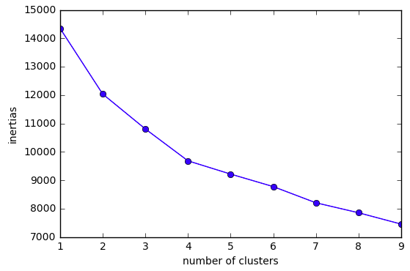
Part II Analysis Overview
Elbow Method for Optimal k
K-means Clustering
Group customers with similar characteristics into clusters and identify high/low opportunity clusters
Use unsupervised machine learning because the data is unlabeled
Optimal number of clusters is 4
Notes:
Y-axis : sum of squared error

Slide 20
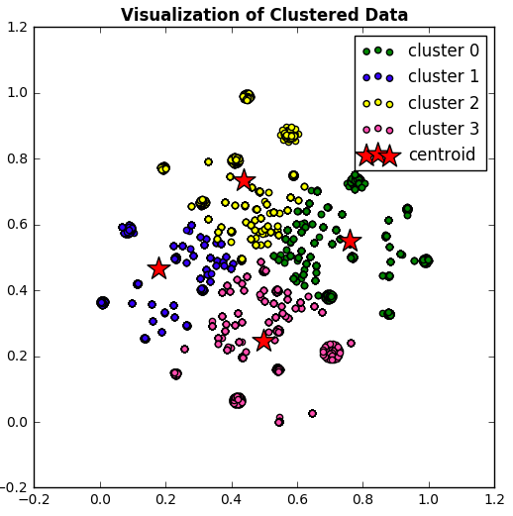
Part II Analysis Overview
Clusters were formed based on customers attributes
Use t-Distributed Stochastic Neighbor Embedding for dimensionality reduction before clustering
The clusters were well separated

Slide 21
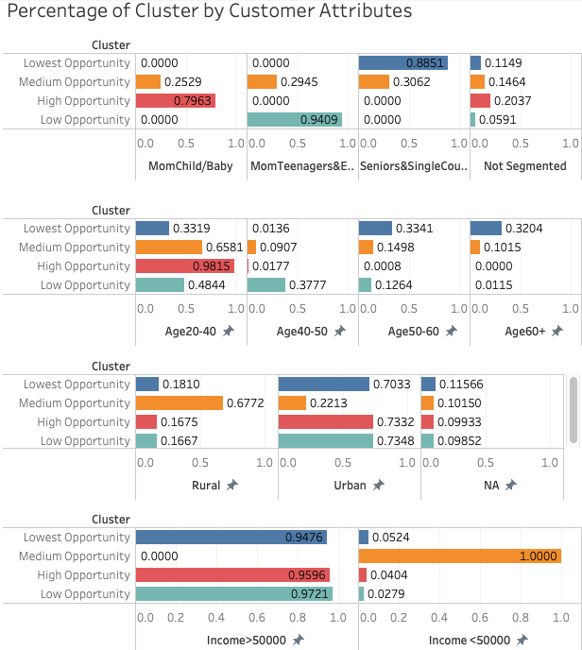
Key Findings I
Identify High vs Low Opportunity Customers
High-Opportunity Customers
Mom with child/baby, age 20-40, income above average, live in urban areas
Low-Opportunity Customers
Few mom with child/baby, age 50+, income above average, live in urban areas

Slide 22
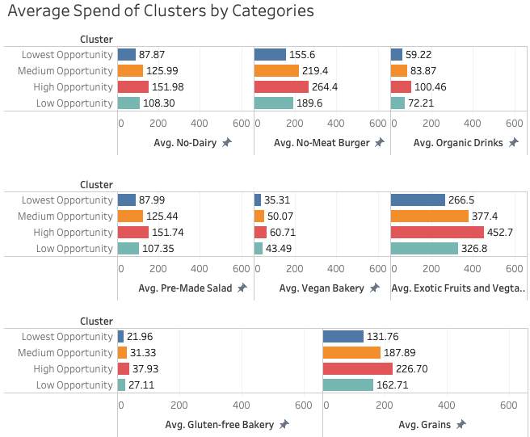
Key Findings II
High opportunity customers spend more in all categories than low-opportunity customers
High-opportunity and low-opportunity customers have similar product preferences and spending habits

Slide 23
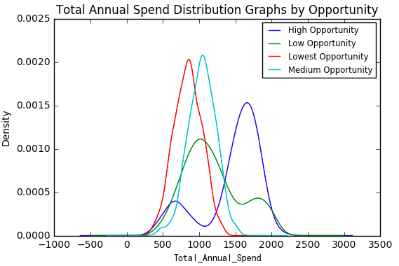
Recommendations
Target customers in the high-opportunity cluster
The highest opportunity cluster represents 24% of the sample
The cluster has the highest percentage of customers age 20-40 (98%)
The cluster has the highest percentage of mom with at least a child or a baby(80%)
The customers in the high-opportunity cluster have the highest average spending
Offer discount on the categories they spend the most on, exotic fruits and vegetables(31%), no-meat burgers(18%) and grains (16%)

